Slide 1

CT ABDOMEN & PELVIS
Dr. Rabab Yasin, MD
Professor of radiology-faculty of medicine
Menoufia University

Slide 2
Indications
Indications for abdominal CT examinations include, but are not limited to:
Evaluation of abdominal, flank or pelvis.
Evaluation of known or suspected abdominal masses or fluid collections.
Evaluation of primary or metastatic malignancies.
Evaluation of abdominal or pelvic inflammatory processes.
Assessment of abnormalities of abdominal or pelvic vascular structures.
Evaluation of abdominal or pelvic trauma.

Slide 3
Clarification of findings from other imaging studies or laboratory abnormalities.
Evaluation of known or suspected congenital abnormalities of abdominal or pelvic organs.
Guidance for interventional or therapeutic procedures within the abdomen or pelvis.
Treatment planning for radiation therapy.
Noninvasive angiography of the aorta and its branches.

Slide 4
Patient preparation
The patient is to starve from eating for a few hours before if intravenous contrast media is to be given, however the patient should be well hydrated to reduce nephrotoxicity of the injected contrast.
Patients undergoing examination of the abdomen and pelvis are required to drink a dilute contrast medium (2% gastrographin) over three hours (200 ml/half an hour) in order to opacity the bowel and distinguish this from local structures with similar attenuation values. This contrast medium may also be administered rectally for examinations of the pelvic viscera.

Slide 5
Instead; oral negative contrast may be used (water) to delineate the bowel loops and stomach.
Examination for gynaecological indications requires a full bladder.
Explain to your patient the examination duration, the contrast he is going to have and its possible adverse reactions.

Slide 6
The examination is done with the patient wearing his or her clothes but insure that contains no metals and there is no metal objects overlying the examined parts eg.: keys, coins, metal belts ..etc.
Instruct the patient to put his hands upward or by his sides (not over his abdomen).
Instruct the patient not to move during the exam.

Slide 7
Precautions
Barium retained in the colon after previous gastrointestinal radiology produces artifacts on CT and barium studies should be deferred if CT is required.
Large metal prostheses such as hip transplants may cause sufficient interference to prevent successful imaging around them. Metal clips used for haemostasis or for marking the margins of tumors also produce significant artifacts.

Slide 8
Safety precautions regarding radiation exposure
Children are 10x more sensitive to radiation induced cancers than adults (girls > boys)
Bone marrow, thyroid, breast, and lung are at greatest risk
Risk from acute exposure appears similar to fractionated exposure.

Slide 9
Other precautions
If the patient weight is more than 200 kgs, contact the scanner operator before the exam. CT scanners have a weight limit. Too much weight can cause damage to the scanner's working parts.
CT is used with care around radiosensitive structures such as the eye, or in children and young people, and only for over-riding indications in pregnant women.

Slide 10
Sedation is only rarely required for patients undergoing CT.
Premedication may be useful for those in pain so that they are able to lie still.
General anaesthesia is required if involuntary or uncontrollable movement may be a problem, particularly in children, although many infants can be examined satisfactorily after a feed or under sedation.

Slide 11
Technique of examination
Examination is usually carried out with the patient supine, Patient direction : Head first although specialized indications may require specific positions.
Exposures typically last a few seconds, and suspended respiration is required as respiratory movement may cause artifact.

Slide 12
Enhancement
Enhancement refers to the commonly used technique of scanning following the intravenous administration of iodine-containing contrast medium.
Two types of contrast materials are available; ionic and non ionic. The first type is cheaper but may cause adverse allergic reaction. If the patient is known to have allergic disease; either inject non ionic contrast or give anti allergic pre medication.
Contrast may be injected either manually or by use of automatic injector ( at a rate of 2 mL/sec). Dose is around 1 cm/kg body weight.

Slide 13
It is commonly used to aid diagnosis by increasing the contrast between normal and abnormal tissues. This technique is routine in the examination of the liver, kidney, and in the investigation of abdominal sepsis or malignancy.
This increases the attenuation of areas which have a circulation, and allows their differentiation from avascular structures such as abscesses, cysts and devascularized tissue.

Slide 14
CT machines can produce a digital radiograph of the examination area at the start of the examination (scanogram).
This allows the examination to be planned accurately and also provides a computerized record of the sections.
The attenuation of tissues on CT is displayed on a wider scale than can be shown effectively on one image, however. The display console therefore allows the image to be manipulated so that areas at different points on the attenuation scale can be examined. Windowing, liver 250/40; abdomen 400/20.

Slide 15
If the request is CT abdomen & pelvis:
Scan Start / End Locations will be 1 cm superior to diaphragm to the lesser trochanters.
When to ensure delayed phase kidney / full bladder ?
Rectal contrast ?

Slide 16
Scout : AP
Scan type : helical
Scan range: dome of diaphragm to ischial tuberosity/ lesser trochanter.
Gantry tilt : none
Kv: 120
mAs:Auto mA (minimum 50-maximum 420)
SFOV & DFOV: adjust to the patient’s size.
Slice thickness: 3 mm, Recon as thin as possible
Interval : 3 mm, Recon as thin as possible
Respiration : inspiration.

Slide 17
Post-processing techniques
There are four main post-processing techniques available:
  Multiplanar reformation (MPR).
  Maximum intensity projection (MIP).
  Shaded surface display (SSD)
  Volume rendering (VR).

Slide 18
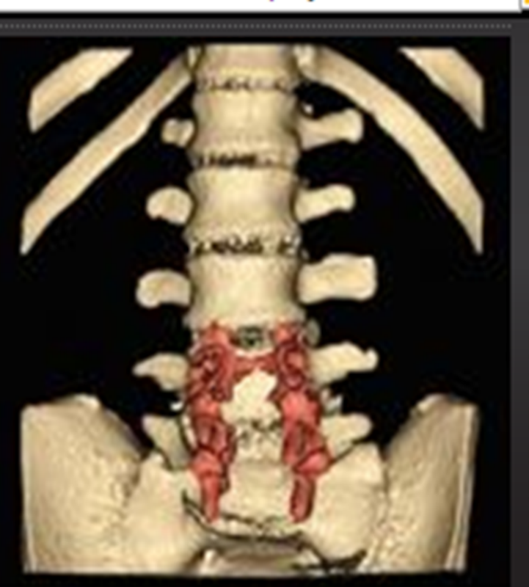
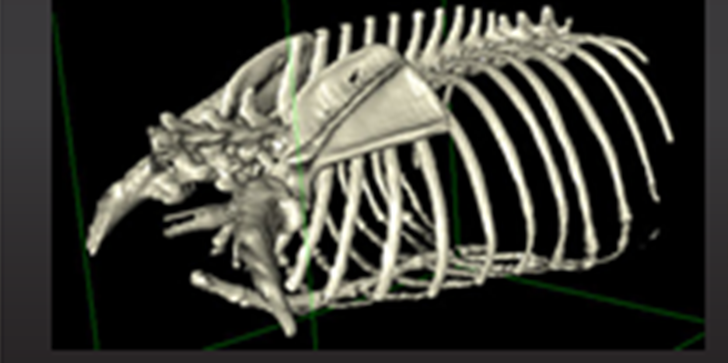
Shaded surface display(SSD)

Slide 19
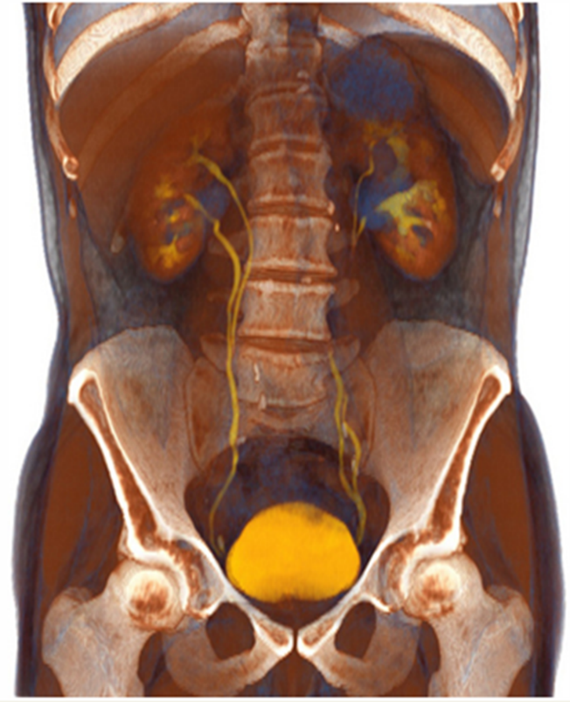
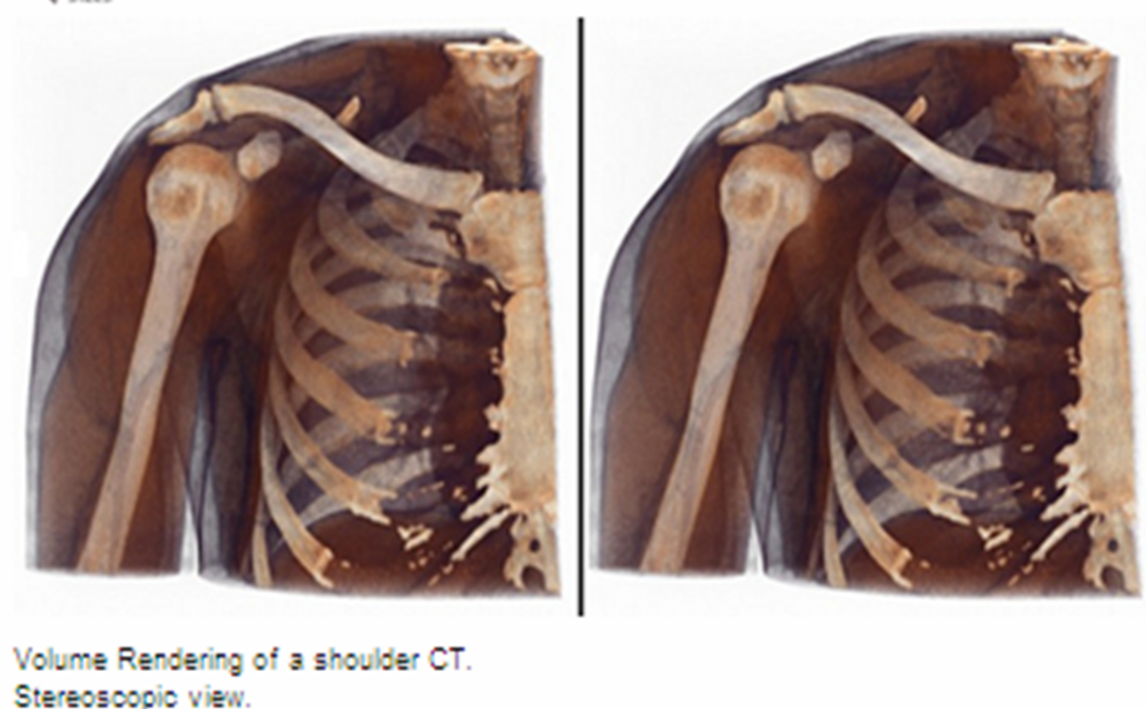
Volume rendering

Slide 20
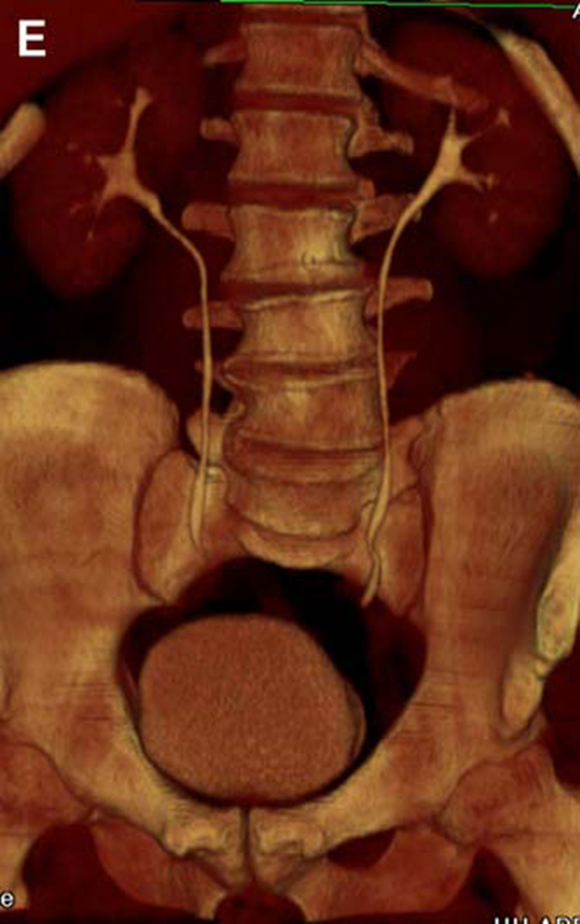
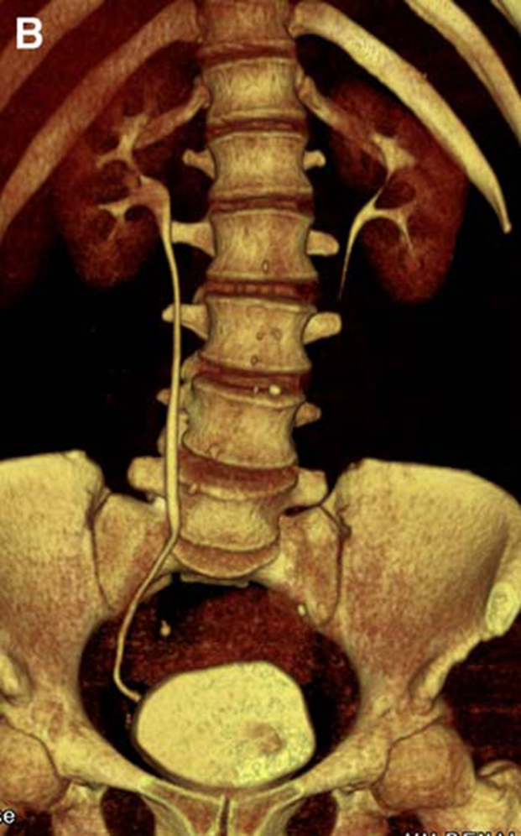
Volume rendering

Slide 21
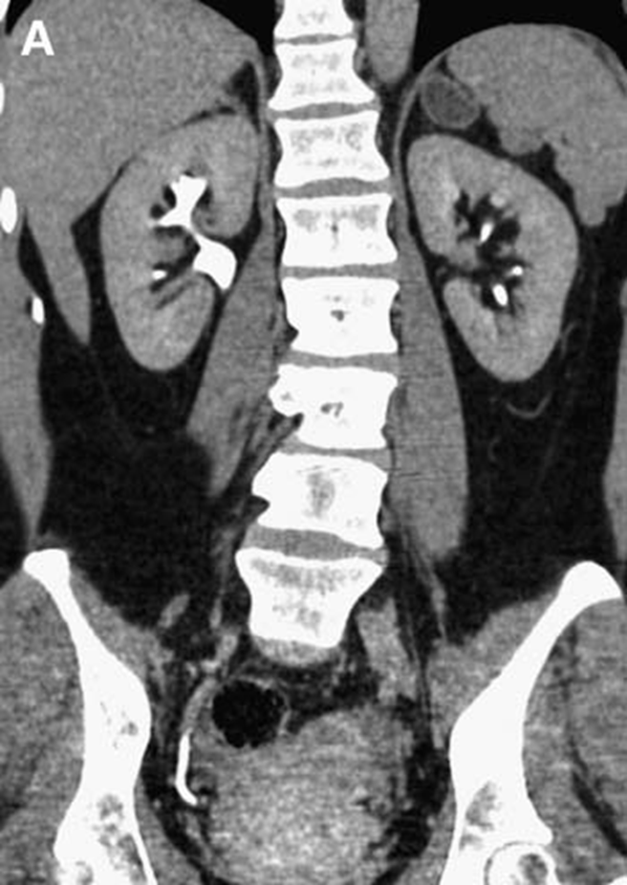
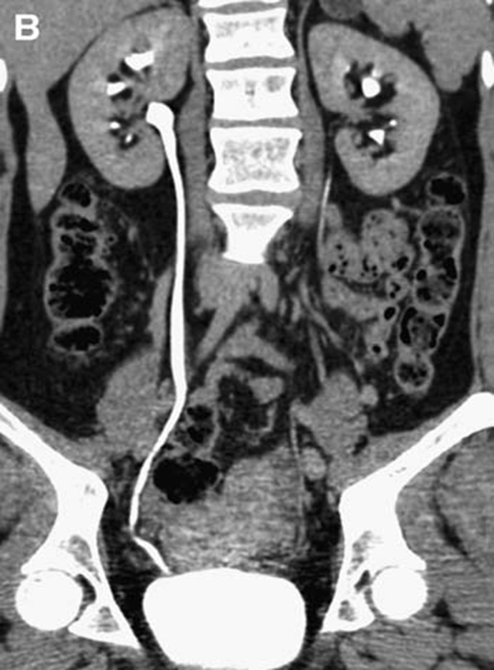
Coronal reformat Curved planer reformat

Slide 22
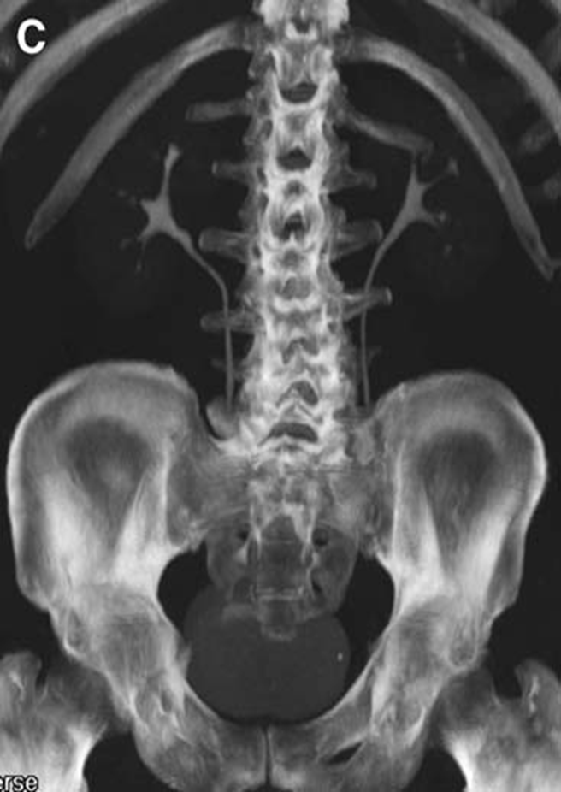
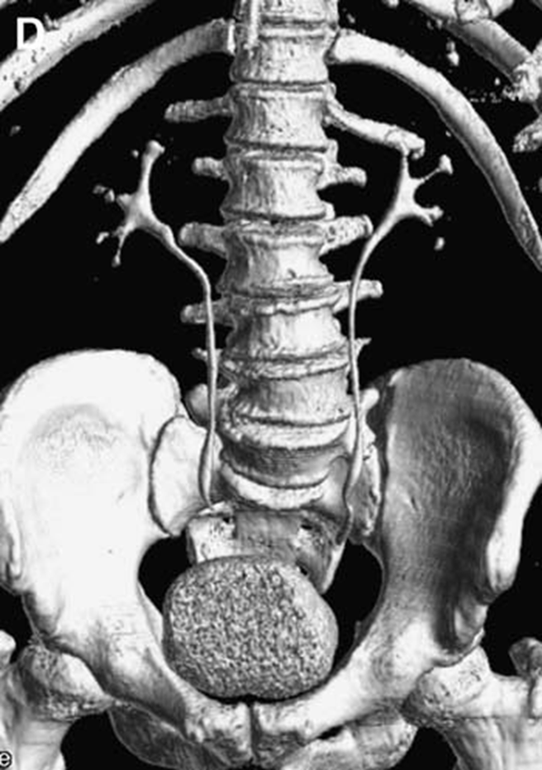
MIP SSD

Slide 23


